Slide 1


Payment reminder application
Deeksha sahu (229024)
Nikhil solankhi(229046)

Slide 2
AGENDA OF THIS DOCUMENTS IS :
Introduction
Objective
UML Diagrams
Screenshots
Specifications
Requirement
Advantages
Disadvantages
Conclusion
Future Enhancement
References

Slide 3
INTRODUCTION
Payment reminder application is a type of time management computer application that is designed to alert the user and their client of important events in our case the due payment that have been input in our program. Most programs provide a calendar or list view of events, as well as a reminding technique. But in this application the reminders are provided through email as well as mobile to the owner of the properties and their clients.

Slide 4
OBJECTIVE
Payment reminder app is useful for those who often forget to pay their rent and for those who find it hard to collect the payment from their clients/tenants. This app reminds them to pay as in case of the tenant and to collect in case of the owner of the properties by sending notifications on email as well as mobile phone. This application makes it very easy to manage the finances and dues.

Slide 5
Technology Used
BACK END → JAVA SPRING BOOT REST API
FRONT END → REACT

Slide 6
UML DIAGRAMS

Slide 7
ER DIAGRAM

Slide 8
ER DIAGRAM MY SQL AUTO-GENERATED

Slide 9
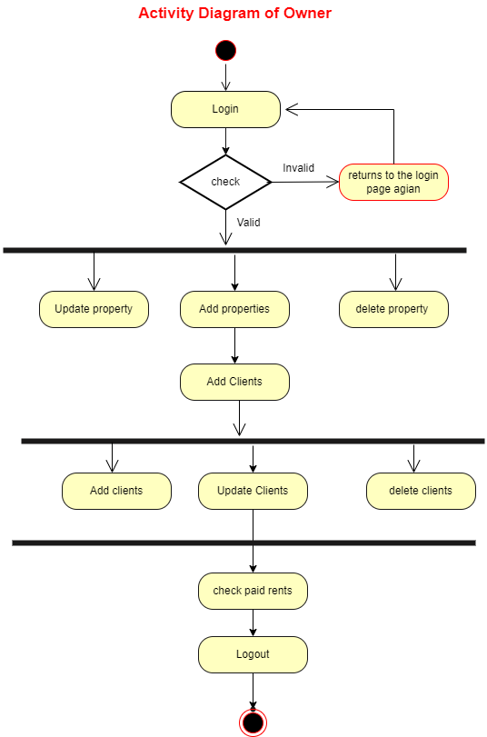
ACTIVITY DIAGRAM OF OWNER

Slide 10
ACTIVITY DIAGRAM OF ADMIN

Slide 11
USE CASE DIAGRAM

Slide 12
DFD DIAGRAM

Slide 13
CLASS DIAGRAM

Slide 14
SCREEN SHOTS

Slide 16
SPECIFICATIONS
The application will use JavaScript, HTML and CSS as main web technologies.
HTTP and FTP protocols are used as communication protocols. FTP is used to upload the web application in live domain and the client can access it via HTTP protocol.
SMTP protocol is used for Email communication.
Several types of validations make this web application secure.
JWT is also used to secure the APIs.
Since PAYMENT REMINDER APP is a web-based application, internet connection must be established.
The PAYMENT REMINDER APP will be used on PCs and will function via internet or intranet in any web browser.

Slide 17
S/W and H/W Requirements
Server Side:
Processor: Intel® Xeon® processor 3500 series
HDD: Minimum 500GB Disk Space
RAM: Minimum 4GB
OS: Windows 10, Linux 6
Database: MySQL
Client Side (minimum requirement):
Processor: Intel Dual Core
HDD: Minimum 80GB Disk Space
RAM: Minimum 2GB
OS: Windows 7, Linux

Slide 18
Advantages
Reach clients through their preferred communication channel for example email.
Provide added security.
Reduce friction in the payment process.
Increased Speed of the operations.
Automated payment reminders are much simpler and faster to process. They can be easily scheduled to arrive in a fixed number of days before or after the due date.
Automated messages allow customers the freedom to open their messages on the move, while also giving them the ability to quickly access the communication at their fingertips rather than searching for a filed-away letter.

Slide 19
Disadvantages

Slide 20
Conclusion

Slide 21
Future Enhancement

Slide 22
References

